Slide 1
The Maximum Clique Problem
Alyssa i mean Angela i mean Alyssa Newman

Slide 2
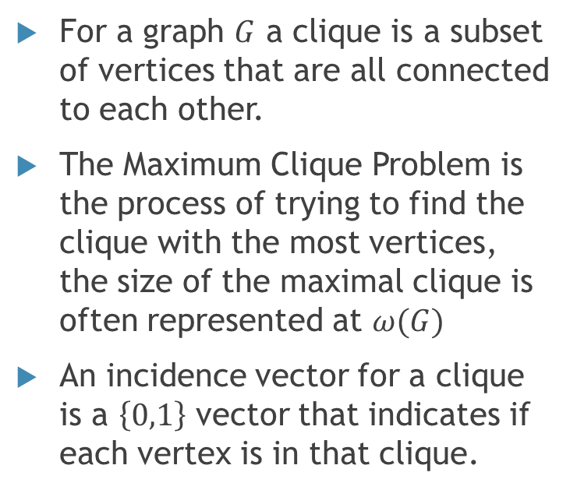
Background-What is the Maximum Clique Problem?
For a graph $G$ a clique is a subset of vertices that are all connected to each other.
The Maximum Clique Problem is the process of trying to find the clique with the most vertices, the size of the maximal clique is often represented at $ω(G)$
An incidence vector for a clique is a $\left\{0,1\right\}$ vector that indicates if each vertex is in that clique.

Slide 3
More About the Maximum Clique Problem
There is no efficient algorithm for finding the maximum clique
Checking if a graph has a clique larger than a given size is NP-Complete
The set of incidence vectors for all cliques in the graph form the V representation for the Polytope for the problem

Slide 4
An Iterative Algorithm Through Feasible Points
3
The Greedy Algorithm
Start with any vertex of the graph,
Find a new vertex that is connected to all collected vertices
Add the new vertex to your collection
Continue until no new vertices can be added
1
2

Slide 5
References
Korte, Bernhard, and Jens Vygen. Combinatorial Optimization: Theory and Algorithms. Springer, 2018.
De Simone, Caterina, and Mosca, Raffaele. Stable set and clique polytopes of (P5,gem)-free graphs. Discrete Mathematics, Volume 307, Issue 22,2007,Pages 2661-2670,ISSN 0012-365X, https://doi.org/10.1016/j.disc.2007.01.010.

